Slide 1
Week 10 DevOps
Dr Zhi Zhang

Slide 2
Overview
DevOps
Fabric
AWS Lambda

Slide 3
What is DevOps?
It is a combination of cultural philosophies, practices and tools created to facilitate organizations in delivering services/applications much faster than they can through traditional software development.

Slide 4
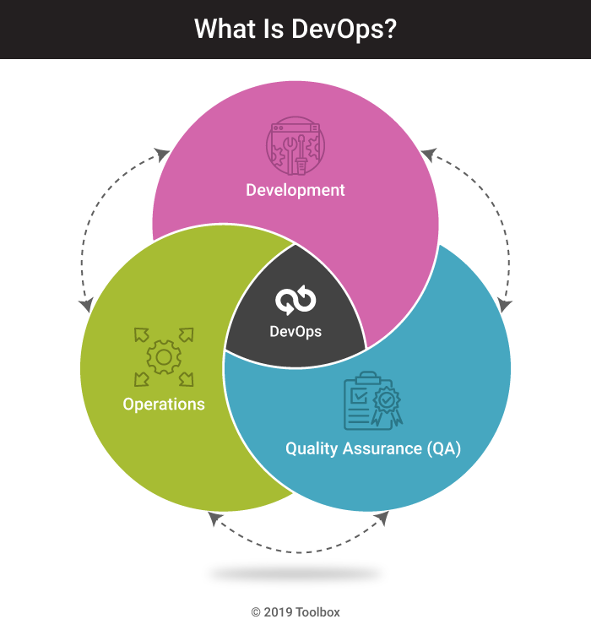
https://www.spiceworks.com/tech/devops/articles/what-is-devops/

Slide 5
DevOps best practices
Microservice
Monitoring and Logging
Continuous Integration
Continuous Delivery
Continuous Deployment

Slide 6
DevOps best practices
Microservice
Builds a single application as a set of small services. Each service runs in its own process and communicates with other services through network.
Applications are broken into many individual microservices with each microservice scoped to a single purpose or function.

Slide 7
DevOps best practices
Microservice
Builds a single application as a set of small services. Each service runs in its own process and communicates with other services through network.
Applications are broken into many individual microservices with each microservice scoped to a single purpose or function.
Benefits: makes the application flexible and enables frequent and small updates.
Example: AWS Lambda.

Slide 8
DevOps best practices
Monitoring and Logging
Organizations monitor metrics and logs to see how application and infrastructure performance impacts the experience of their product’s end user.
Benefits: tracks the performance of applications and infrastructure and detects real-time problems.
Example: AWS CloudWatch.

Slide 9
DevOps best practices
Continuous Integration
Continuous Delivery
Continuous Deployment

Slide 10
The software/application release process:
Source Control:
Developers use a VCS (Version Control System) to manage and track changes to a code repository.
Run Build and Unit Tests:
Deploy to Test Environment:
Deploy to Production Environment:

Slide 11
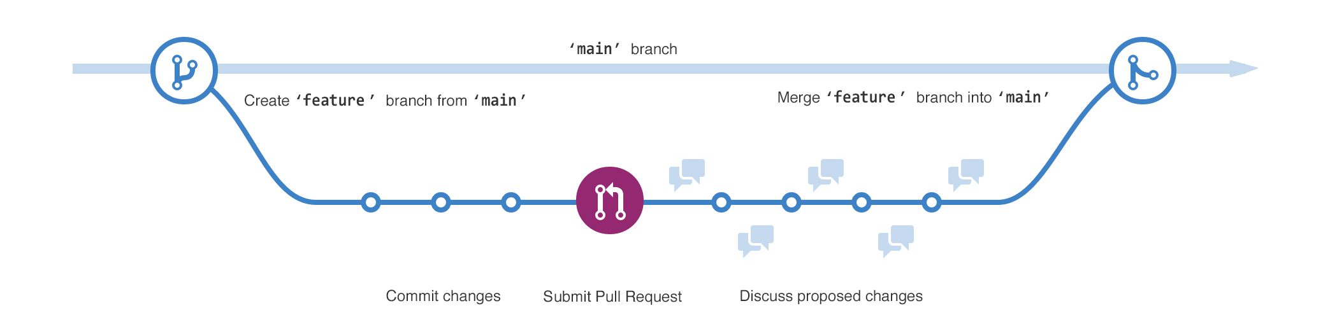
The software/application release process:
Source Control:
Developers use a VCS (Version Control System) to manage and track changes to a code repository.
https://docs.github.com/en/get-started/start-your-journey/hello-world#step-2-create-a-branch

Slide 12
The software/application release process:
Source Control:
Run Build and Unit Tests:
Build refers to automatically generating executables for the application.
Automated unit tests are executed to ensure that individual components of the application function correctly.
Failures in build and unit tests alert the developers.
Deploy to Test Environment:
Deploy to Production Environment:

Slide 13
The software/application release process:
Source Control:
Run Build and Unit Tests:
Deploy to Test Environment:
Automated deployment to the test environment.
Test Environment: a dedicated test environment mirrors the production environment but is isolated for testing purposes.
Test includes functional testing, integration testing, workload testing, etc.
Deploy to Production Environment:

Slide 14
The software/application release process:
Source Control:
Run Build and Unit Tests:
Deploy to Test Environment:
Deploy to Production Environment:
The application is deployed to the production environment for serving real users.

Slide 15
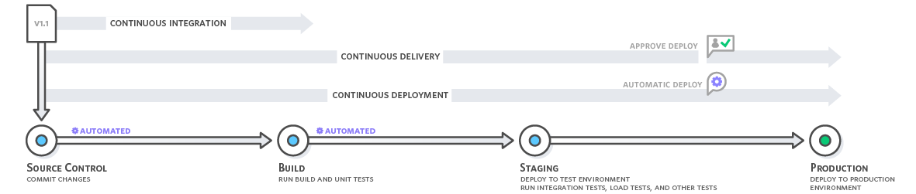
The software/application release process:
Source Control:
Run Build and Unit Tests:
Deploy to Test Environment:
Deploy to Production Environment:

Slide 16
DevOps best practices
Continuous Integration
Every time developers merge their code changes into a central repository, automated builds and tests start: Whenever a change is committed, the automated build and test will be triggered.
Benefits: ?
https://aws.amazon.com/devops/continuous-integration/

Slide 17
DevOps best practices
Continuous Integration
Every time developers merge their code changes into a central repository, automated builds and tests start: Whenever a change is committed, the automated build and test will be triggered.
Benefits: Improve Developer Productivity, Find and Address Bugs Quicker, Deliver Updates Faster
https://aws.amazon.com/devops/continuous-integration/

Slide 18
DevOps best practices
Continuous Delivery and Continuous Deployment:
Expand upon continuous integration by deploying all code changes to a testing environment and/or a production environment after the build stage.
Benefits: ?
https://aws.amazon.com/devops/continuous-integration/

Slide 19
DevOps best practices
Continuous Delivery and Continuous Deployment:
Expand upon continuous integration by deploying all code changes to a testing environment and/or a production environment after the build stage.
Benefits: Continuous Integration + Automate the Software Release Process
https://aws.amazon.com/devops/continuous-integration/

Slide 20
Fabric: automate tasks in DevOps
Fabric is a high level Python library designed to execute shell commands remotely over SSH, yielding useful Python objects in return.
OpenSSH: a widely used version of the SSH protocol, available on Mac, Linux/Unix and Windows.
Question: how is OpenSSH used for user/client authentication?

Slide 21
User/Client Authentication in SSH
https://sebastien.saunier.me/blog/2015/05/10/github-public-key-authentication.html

Slide 22
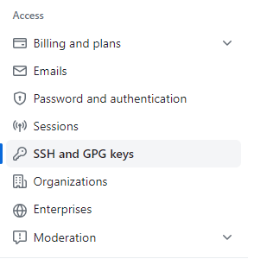
Add the public key to GitHub
Check for existing OpenSSH key pairs:
ls ~/.ssh
Generate OpenSSH keys if no key pairs exist:
ssh-keygen -t rsa -b 4096 -C email@example.com
private key: id_rsa
public key: id_rsa.pub
Add the Public Key to GitHub:

Slide 23
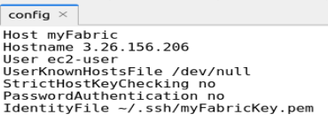
How to configure OpenSSH to support Fabric
Install fabric using: pip install fabric
Create a config file in ~/.ssh

Slide 24
How to configure OpenSSH to support Fabric
Install fabric using: pip install fabric
Create a config file in ~/.ssh
Question: Some lines in the configuration above will make the SSH connection NOT secure? What are they? Justify your answer.

Slide 25
How to configure OpenSSH to support Fabric
Install fabric using: pip install fabric
Create a config file in ~/.ssh
Question: Some lines in the configuration above will make the SSH connection NOT secure? What are they? Justify your answer.
Both “UserKnownHostsFile /dev/null” and “StrictHostKeyChecking no” disable host key checking, making the connection insecure to the client.
To explain why, we need to be aware of “server/host authentication”.

Slide 26
Server/Host Authentication in SSH
Key pair: host key is a key pair. Public host key is stored on and distributed to different clients, and private key is stored on the host/server.
Key Exchange: when a client attempts to connect to a server for the first time

Slide 27
Server/Host Authentication in SSH
Key Exchange: when a client attempts to connect to a server for the first time, the server presents its host public key to the client.

Slide 28
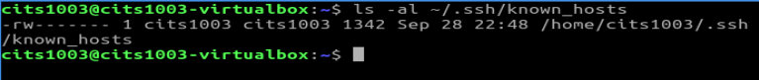
Server/Host Authentication in SSH
The host-key database is called known_hosts in Linux and contains known host keys.

Slide 29
Server/Host Authentication in SSH
Host Key Checking: The client checks the server's host key against a copy stored in its "known_hosts" file. If the check succeeds, the server is authenticated.

Slide 30
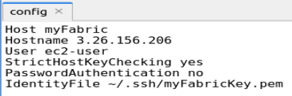
Enable Server/Host Authentication in SSH

Slide 31
Fabric: common functions
from fabric import Connection
c = Connection('myFabric')
upload a local file to the remote server
c.put(localfile, remotefilepath)
run a remote command
c.run(command, otherargs)
run a remote command with sudo
c.sudo(command, otherargs)

Slide 32
Fabric: common functions
from fabric import Connection
c = Connection('myFabric')
upload a local file to the remote server
c.put(localfile, remotefilepath)
run a remote command
c.run(command, otherargs)
run a remote command with sudo
c.sudo(command, otherargs)
Question: what are the differences between 'sudo' and 'su'?

Slide 33
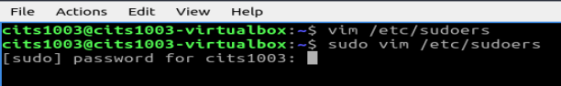
Question: what are the differences between 'sudo' and 'su’?
sudo (Superuser Do): allows a user to execute specific commands that require superuser privileges.

Slide 34
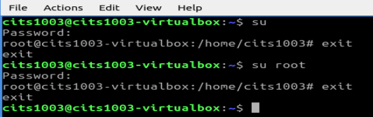
Question: what are the differences between 'sudo' and 'su’?
sudo (Superuser Do): allows a user to execute specific commands that require superuser privileges.
su (Switch User): allows a user to switch to another user account by entering that user account's password.

Slide 35
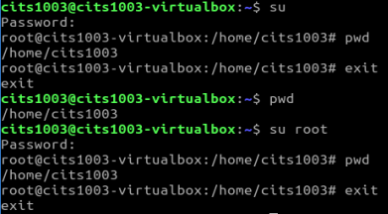
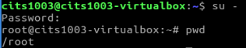
su: current working directory does not change.
su - : current working directory changes.

Slide 36
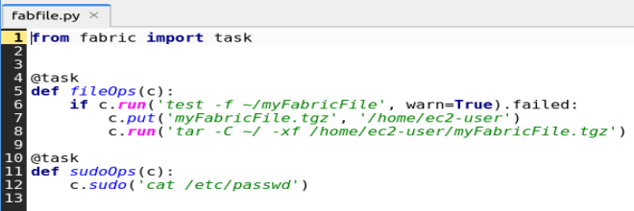
fabfile.py: a Python script that is a collection of tasks and functions
@task is a decorator from the Fabric library.
Question: what does the code snippet above primarily do?

Slide 37
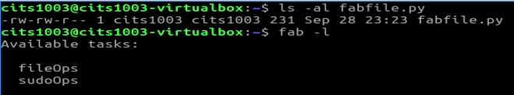
Execute fabfile.py
Navigate to the directory where the fabfile.py resides:

Slide 38
AWS Lambda: automate tasks in DevOps
Lambda: a microservice that lets us run code without provisioning or managing servers. With Lambda, all we need to do is supply our code in one of the language runtimes that Lambda supports.
Two main benefits:
Automatic Scaling: Lambda automatically adjusts compute resources based on the workload, scaling up or down seamlessly without manual intervention.
Server Management: Lambda abstracts away all server and operating system maintenance. It manages the underlying infrastructure, allowing users to focus on their code and business logic.

Slide 39
AWS Lambda: automate tasks in DevOps
Examples:
A toy lambda function
A combination of lambda function and S3

Slide 40
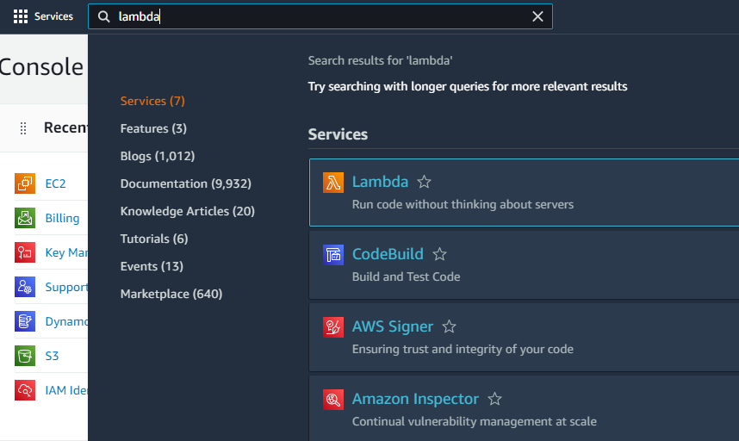
Step1: open the AWS Lambda Console

Slide 41
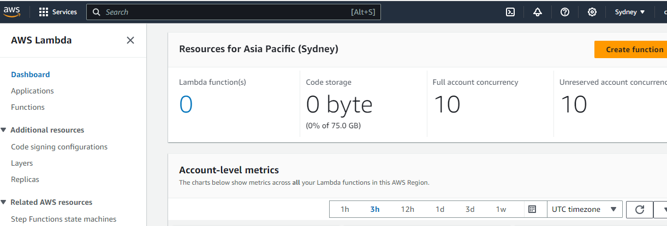
Step1: open the AWS Lambda Console

Slide 42
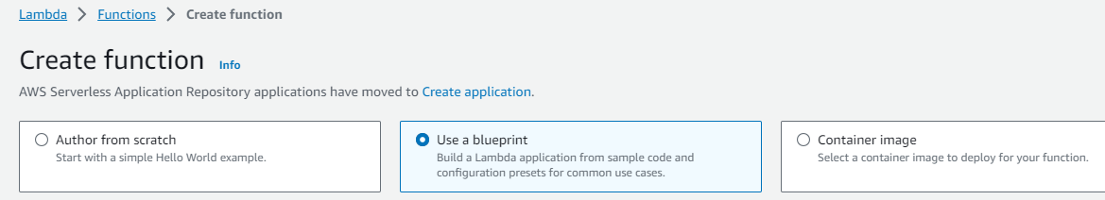
Step2: select a Lambda blueprint and configure it

Slide 43
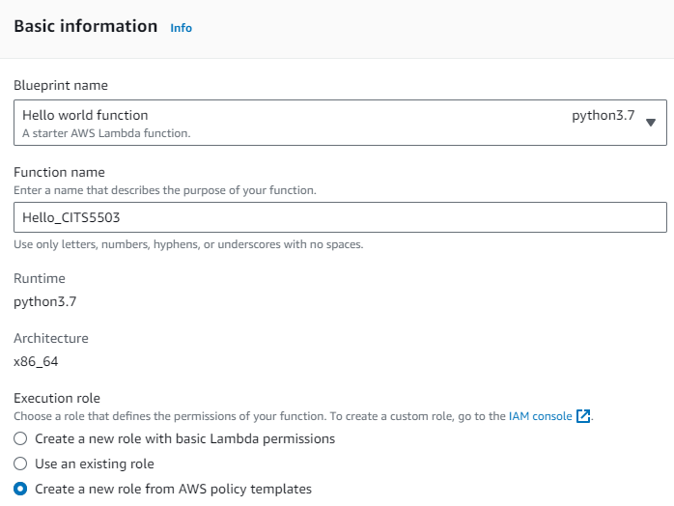
Step3: basic information configuration

Slide 44
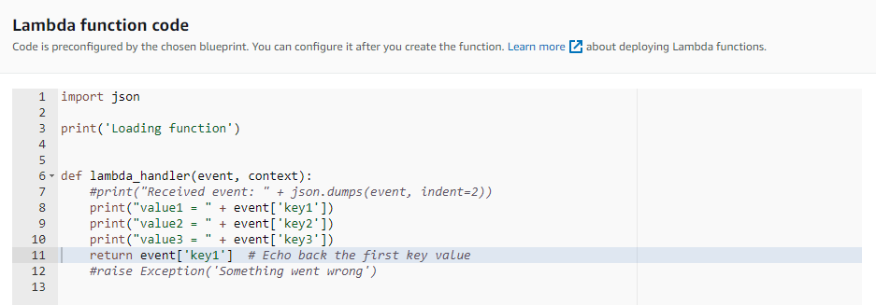
Step4: preconfigured function code

Slide 45
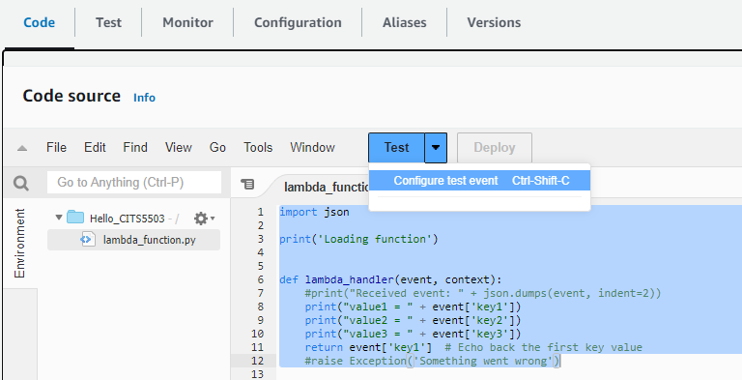
Step5: configure an event to trigger the code

Slide 46
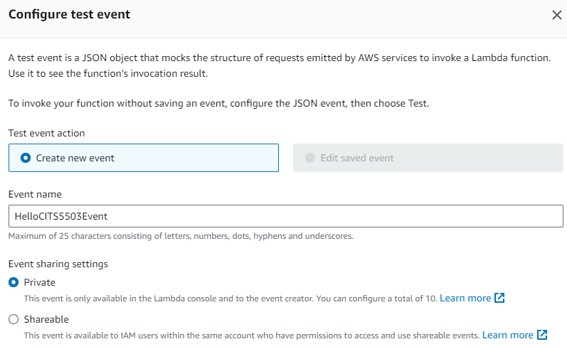
Step5.1: configure an event

Slide 47
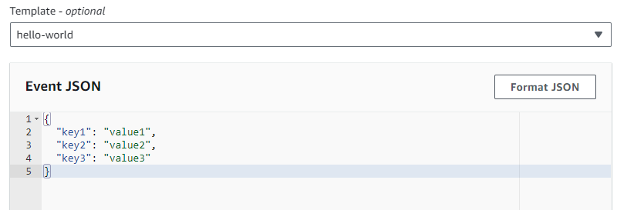
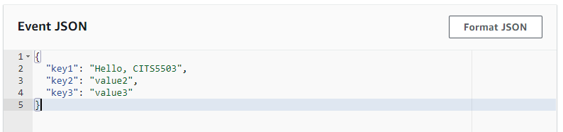
Step5.2: configure the event’s data

Slide 48
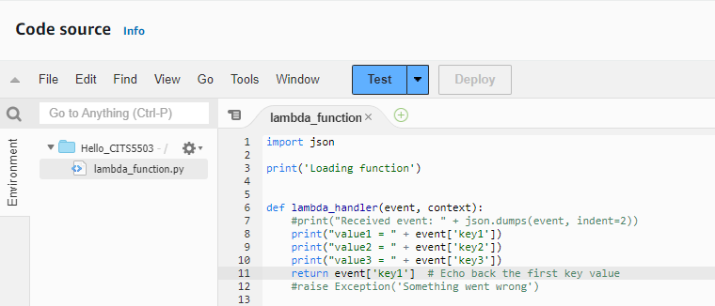
Step6: trigger the Lambda function via the event

Slide 49
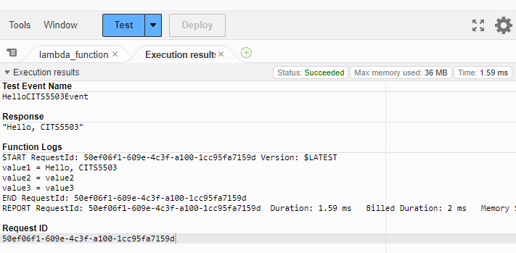
Step7: Execution results

Slide 50
AWS Lambda: automate tasks in DevOps
Example:
A toy Lambda function
A combination of lambda and S3

Slide 51
Combine Lambda with S3
Step 1
Step 2
Step 3
IAM
IAM
S3 BUCKET
Create policy
policy
Create BUCKET
Create role
Test with trigger
Lambda
Lambda
S3
function
role
Lamda
Create function
Add S3 trigger
CloudWatch
Step 6
Step 5
Step 4

Slide 52
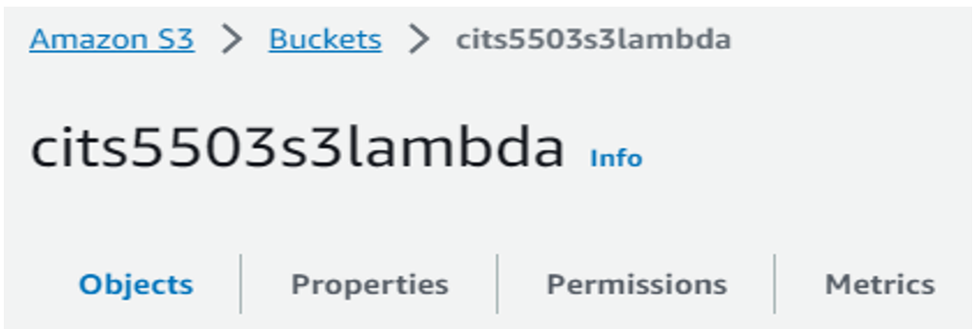
Step1: create a bucket

Slide 53
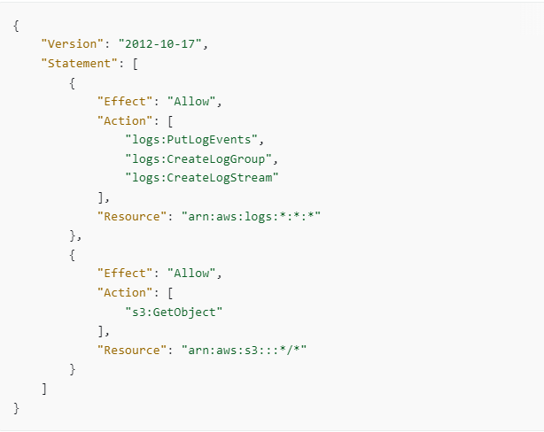
Step2: create a permissions policy

Slide 54
Step2: create a permissions policy
log event: an entry in the log (e.g., a message or an error).
log stream: a sequence of log events that share the same source (e.g., a component within an AWS application).
log group: a group of log streams that share the same monitoring settings (e.g., an AWS application).

Slide 55
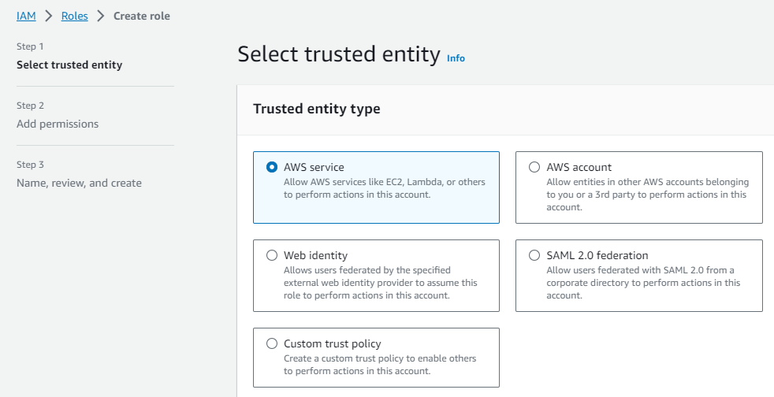
Step3: create a role

Slide 56
AWS account: another AWS account (or entities within that account) is trusted to assume a role in this account.
Web identity: users authenticated through an external web identity provider are trusted to assume a role in this account.
SAML (Security Assertion Markup Language) 2.0 Federation: users authenticated via their corporate credentials (e.g., Microsoft Active Directory) are trusted to assume a role in this account.
Custom trust policy: provides more flexibility in defining who or what is trusted to assume a role in this account.

Slide 57
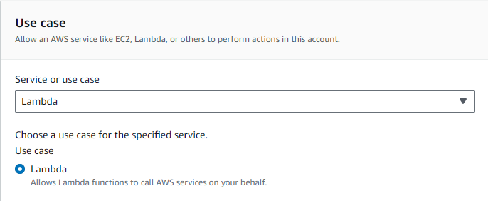
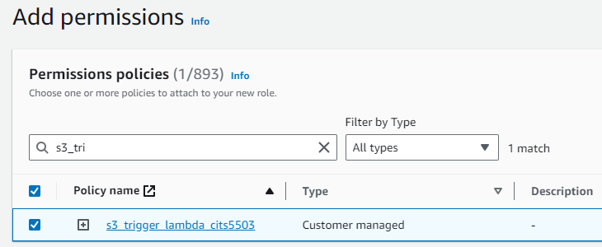
Step3.1: create a role

Slide 58
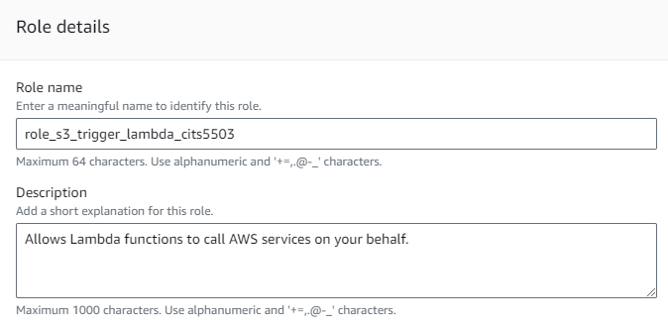
Step3.2: create a role

Slide 59
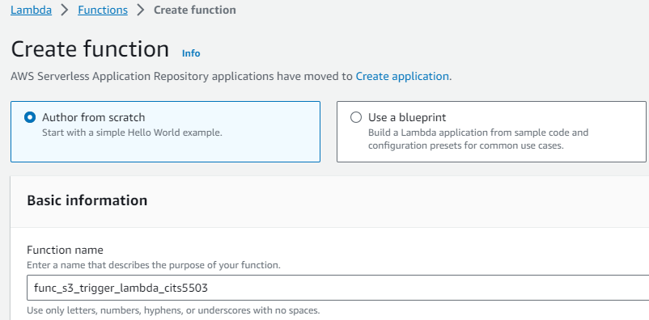
Step4: create a lambda function

Slide 60
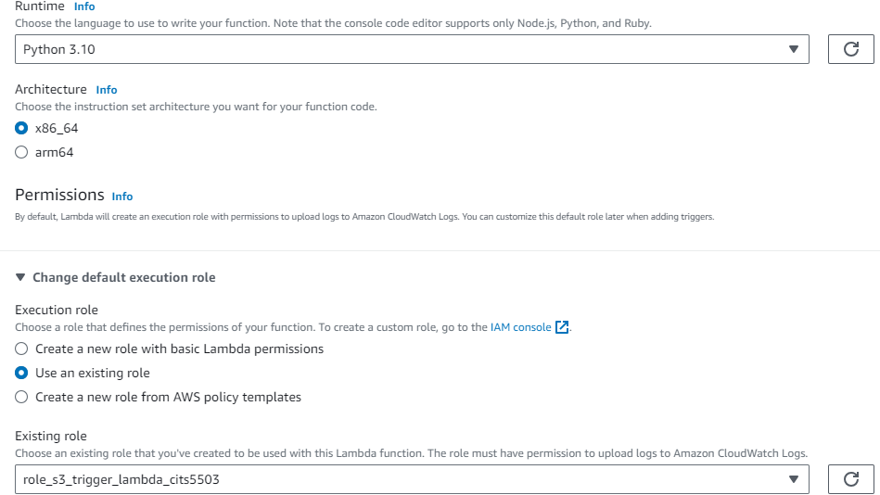
Step4.1: create a lambda function

Slide 61
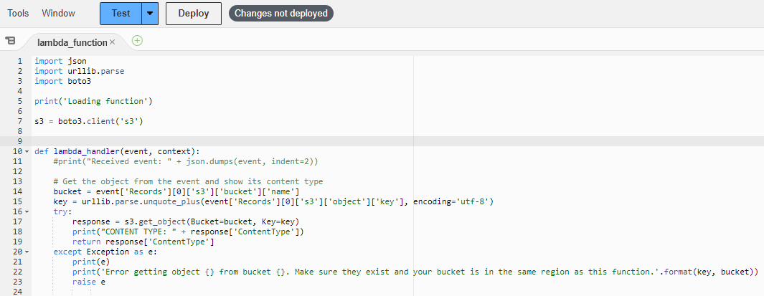
Step4.2: create a lambda function

Slide 62
Step4.3: create a lambda function
event['Records']: contains an array of records. A record corresponds to a specific event that triggered the lambda function.
event['Records'][0]: retrieves the first record in this array.
event['Records'][0]['s3']: contains information specific to an S3 event in the record.
event['Records'][0]['s3']['bucket']: contains information about the S3 bucket where the S3 event occurred.
event['Records'][0]['s3']['bucket']['name’]: retrieves the name field from the bucket.

Slide 63
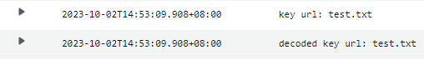
Step4.4: create a lambda function
event['Records'][0]['s3']['object']['key']: retrieves the S3 object key from the S3 object, encoded by utf-8.
urllib.parse.unquote_plus(): a function call that decodes an encoded URL string.
encoding='utf-8: specifies the character encoding to be used when decoding the object key.

Slide 64
Step4.5: create a lambda function

Slide 65
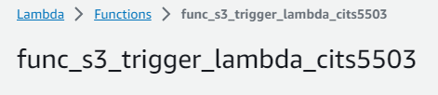
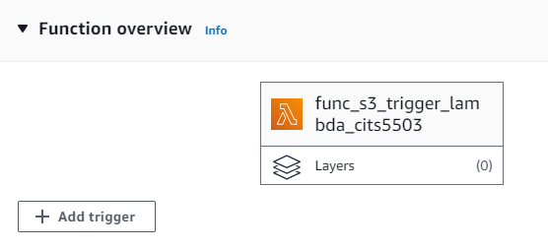
Step5: create a trigger

Slide 66
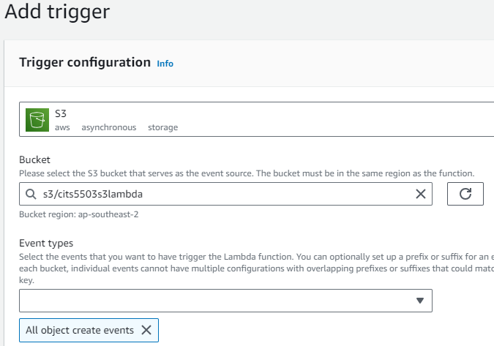
Step5.1: create a trigger

Slide 67
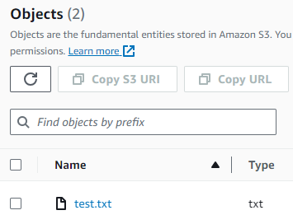
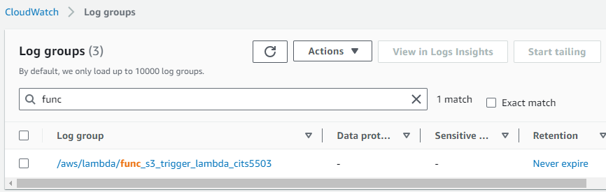
Step6: test the function via the trigger

Slide 68
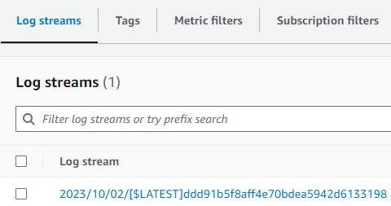
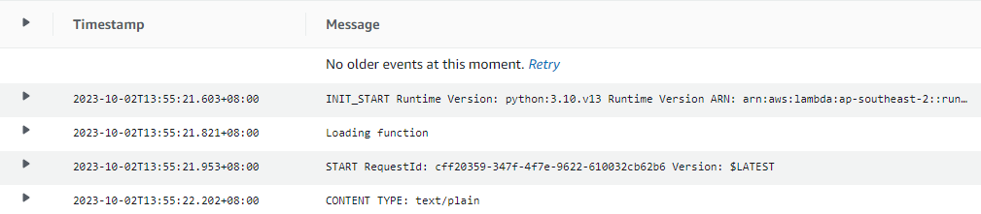
Step6.1: test the function via the trigger

